Slide 1


Team 6: Telescope Autofocuser
Bi-Weekly Update 2 Albin Myscich
Alonna Too-Chiobi
Camille Watson
Joseph Basdeo
Sponsor: Dr. Kevin Nowka TA: Max Lesser
Notes:
Michelle

Slide 2
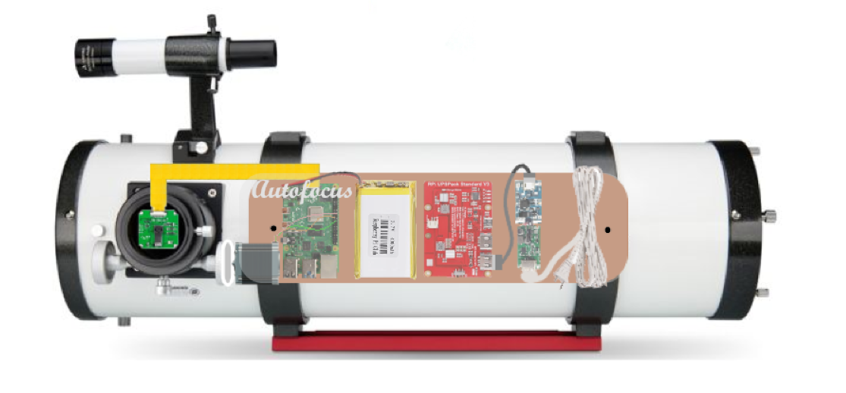
Project Summary
Telescope focusing & image processing automation
Product Will:
Stream current images to dev board using an imager
Autofocus using a stepper motor interface
Display focused image post processing through a GUI
Notes:
Kyle

Slide 3
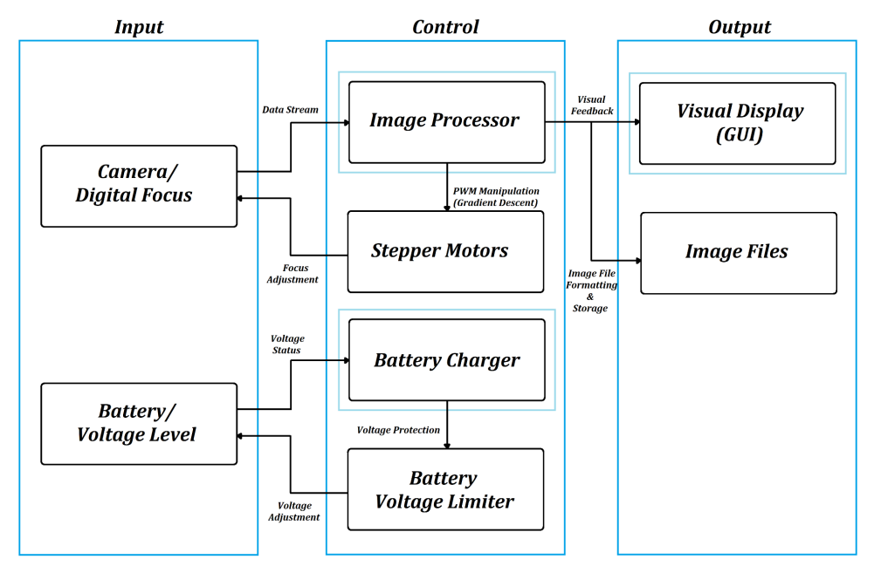
Project/Subsystem Overview
Notes:
Here is a refresher on how the different subsystems relate to each other. Nothing has changed since our first presentation. The camera is still communicating with the image processor who is talking to the GUI, image files, and stepper motors; and the battery is still communicating with the charger who is communicating with the voltage limiter who is then talking back to the battery.

Slide 4
Project/Subsystem Overview
Owner | Subsystem | Requirements
Albin Myscich | Image Post-processing Focuser Automation | Receives real-time and post-processed images and applies an intelligent system interface capable of refining target images Receives a continuous stream of data from Imager, and adjusts the focal distance from itself and the mirrored lens via a stepper motor
Alonna Too-Chiobi | Motor Programs Motor Mounting Assembly | Adjusts focus of telescope depending on input received from image processor Adjusts position of the telescope to account for the Earth’s rotational movement Responsible for ensuring position and security of motors
Camille Watson | Power Interfacing & Redundancy | Provides the Raspberry Pi board, motors, and imager with sufficient power to smoothly perform their functions
Joseph Basdeo | Imager Imager Mounting Assembly Graphical User Interface (GUI) | Capture images through telescope focuser Display Image using a GUI Responsible for position and security of camera
Notes:
Task partitions have remained the same

Slide 5
Project Timeline
Subsystem Designs and Testing (completed 4/21) | Integration of Motors, Autofocusing Program, and Imager Subsystems (to completed by 10/28) | Integration of Image Processor and GUI (to completed by 10/28) | Integration of Power Supply with all Dependent Subsystems (to completed by 10/28) | Final Integration (to complete by 10/28) | System Test (to complete by 11/18) | Validation (to complete by 11/25) | Demo and Report (to complete by 12/2)
Notes:
Eric

Slide 6
Motor & Mounting Assembly
Alonna Too-Chiobi
Accomplishments since last update | Ongoing progress/problems and plans until the next presentation
Obtained a Celestron eq-2 (German equatorial mount) and a Celestron 93514 motor driver in preparation for integrating mount with motor and autofocusing subsystems | Create program for Celestron 93514 motor driver Inquire with autofocusing subsystem about system integration

Slide 7
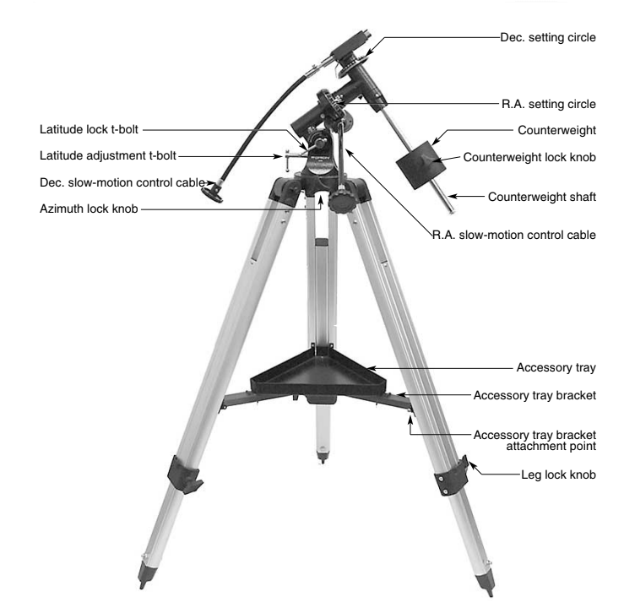
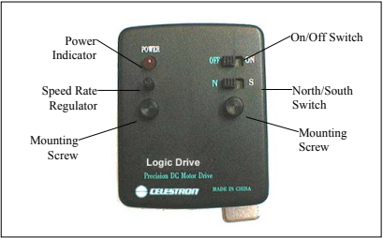
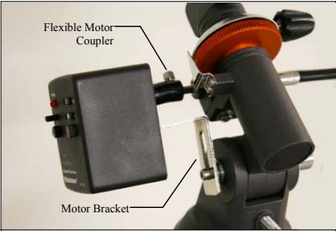
Motor Assembly
Alonna Too-Chiobi
Equatorial Mount . (2014). Orion Telescopes & Binoculars . Retrieved September 12, 2022, from https://www.telescope.com/.
Celestron 932514 Motor Drive. (2008). celestron . Retrieved September 12, 2022, from https://www.celestron.com/products/astromaster-powerseeker-motor-drive.
Notes:
Equatorial Mount . (2014). Orion Telescopes & Binoculars . Retrieved September 12, 2022, from https://www.telescope.com/.
Celestron 932514 Motor Drive. (2008). celestron . Retrieved September 12, 2022, from https://www.celestron.com/products/astromaster-powerseeker-motor-drive.

Slide 8
Imager & Mounting Assembly
Joseph Basdeo
Accomplishments since last update | Ongoing progress/problems and plans until the next presentation
Designed and built dev board mount and verified it attaches securely to telescope in preparation for creating a central platform to house subsystem components | Calibrate and test telescope collimation Integrate imager with motor assembly code GUI, need to include equatorial mount interface

Slide 9
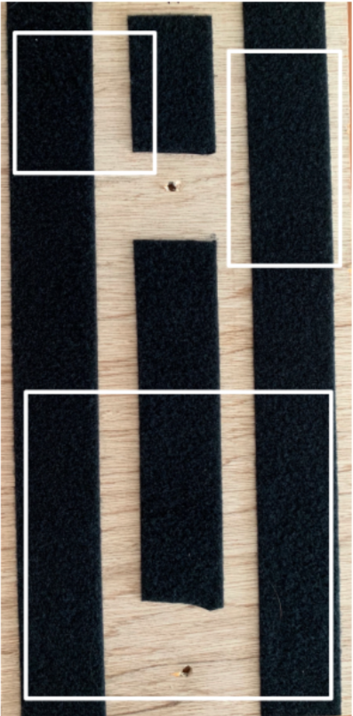
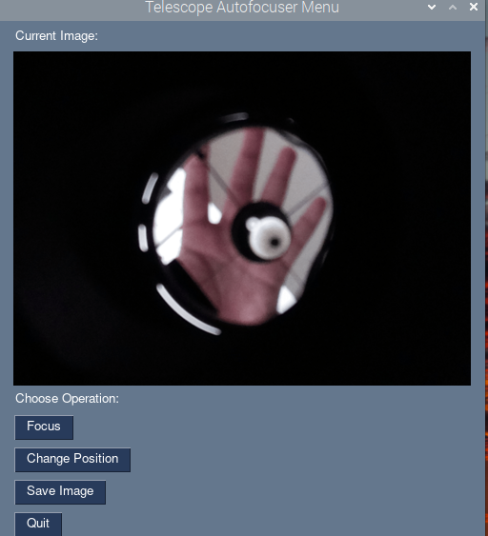
Imager and Mounting Assembly
Joseph Basdeo
Raspberry Pi
Power Supply
Stepper Motor
Demo GUI Menu
Dev Board Mount

Slide 10
Power Supply
Camille Watson
Accomplishments since last update | Ongoing progress/problems and plans until the next presentation
Resolved Altium design issues Finished routing PCB | Validate PCB and generate files Ensure PCB will be properly soldered by practicing on kit

Slide 11
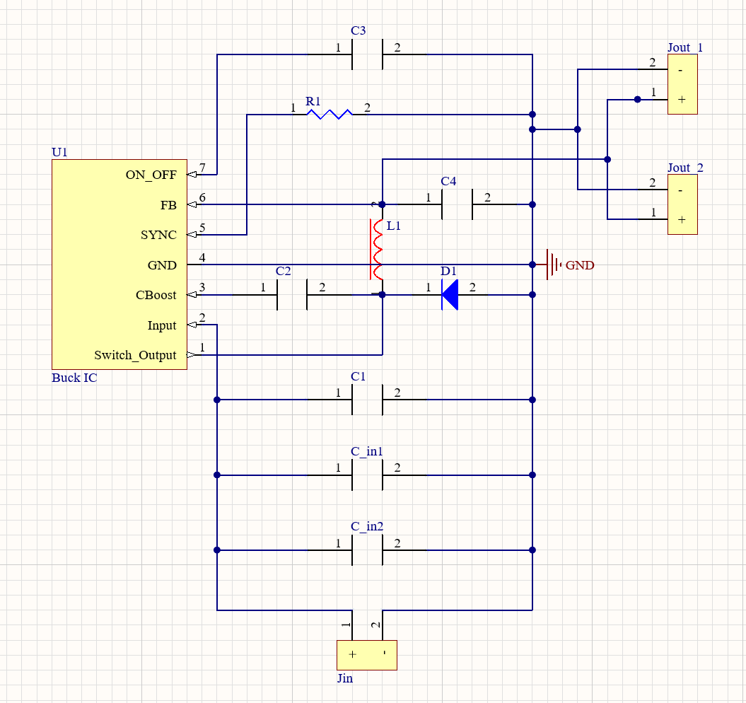
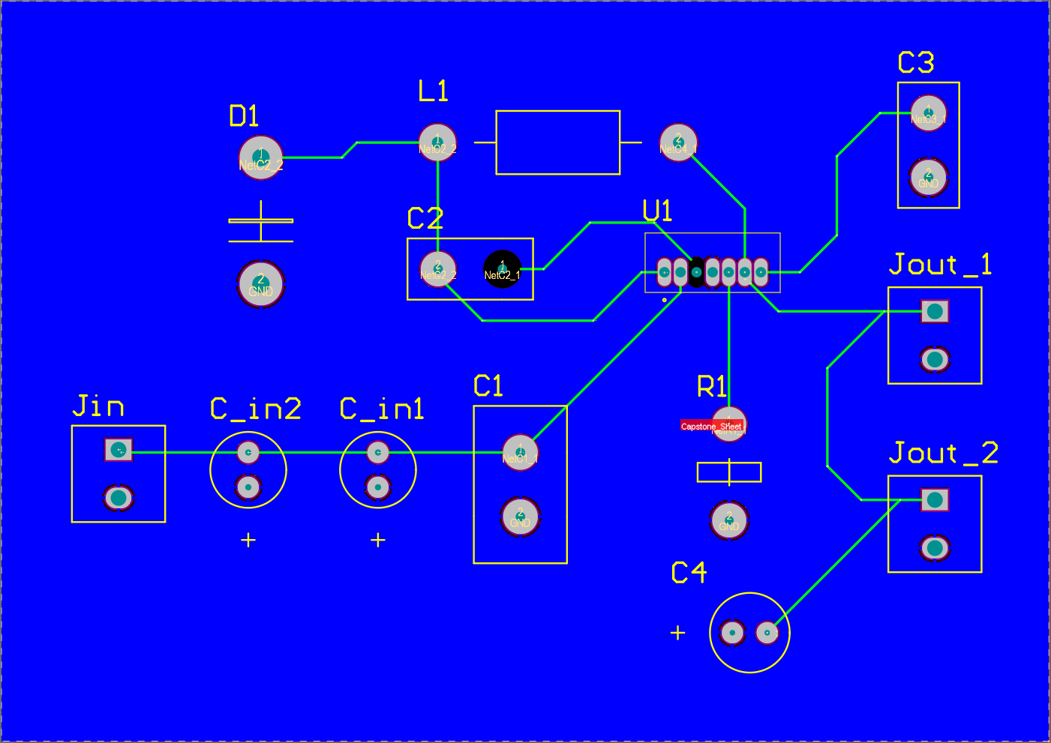
Power Supply
Camille Watson
Altium PCB for Buck Converter
Altium Schematic for Buck Converter

Slide 12
Image Processing & Autofocusing Program
Albin Myscich
Accomplishments since last update | Ongoing progress/problems and plans until the next presentation
Completed integration between: main.py autofocus.py postprocess.py optimize.py test/train.h5 Local machine navigation/interaction Added 300+ new images to training data | System agnostic navigation/interaction DRY code for easy debug and integration to GUI Add more training data to training dataset

Slide 13
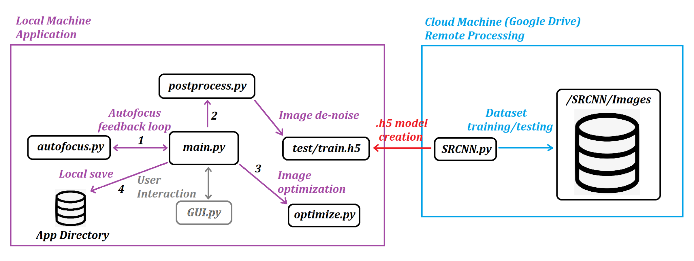
Image Processing &
Autofocusing Program
Albin Myscich
System Interaction Diagram

Slide 14
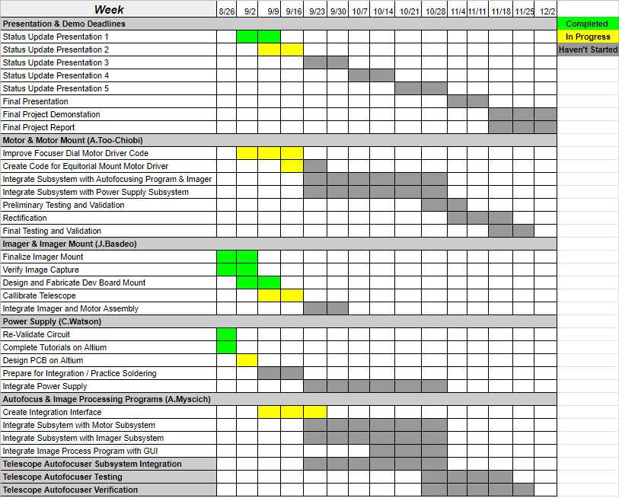
Execution & Plan
Notes:
Michelle

Slide 15
Thank You
Questions?

